Slide 1
MCS 8302
CNS 2205
Network Programming
Network Address Translation

Slide 2
Introduction
Network Address Translation involves changing the Source IP or Destination IP or both source IP and destination IP of packets to a different IP address
  This can be done for packets that are being sent out of a network or for packets that have been received from another network (or computer)
Notes:
https://www.karlrupp.net/en/computer/nat_tutorial

Slide 3
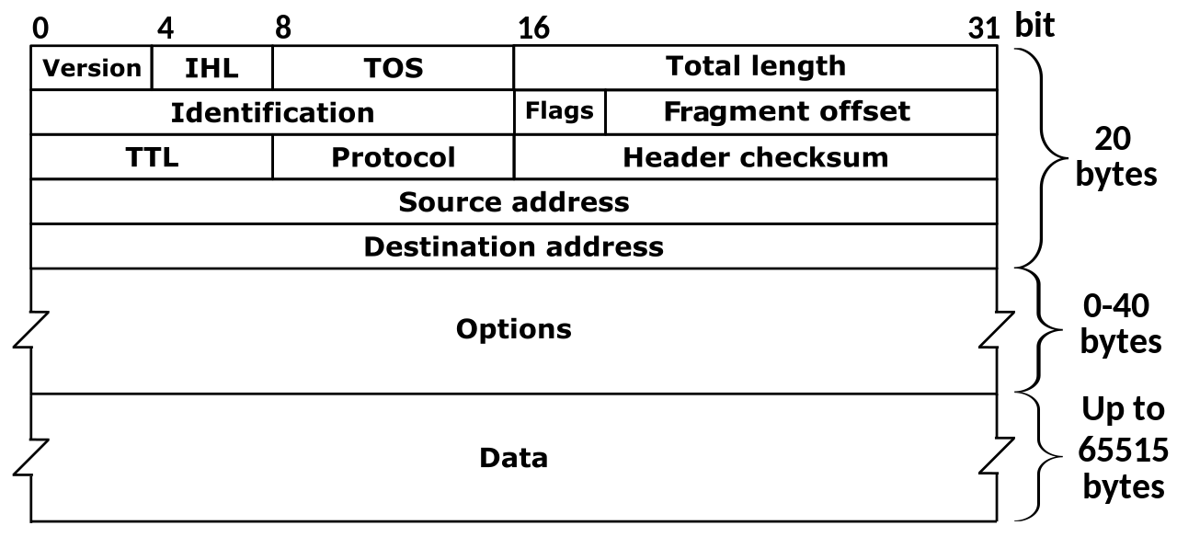
IP Packet
The structure of an IP packet is shown bellow
  NAT is used to alter the value of the Source address and/or destination address

Slide 4
Uses of NAT
NAT is mainly implemented in two ways
  Static NAT is mostly used in data centers e.g. AWS cloud, to map a public IP address (that is configured to a router) to a private IP address that is configured on the cloud server
  NAPT is used in homes, businesses, universities and other enterprises to enable many client computers that are configured with private IP addresses to share one public IP address to access the Internet

Slide 5
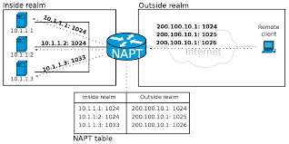
Uses of NAPT
NAPT enables multiple computers on the LAN (inside realm) to share the router’s public IP address (200.100.10.1)
  Is there a limit to the maximum number of computers that can share 1 IPv4 public IP address? (Hint: Number of available port numbers)

Slide 6
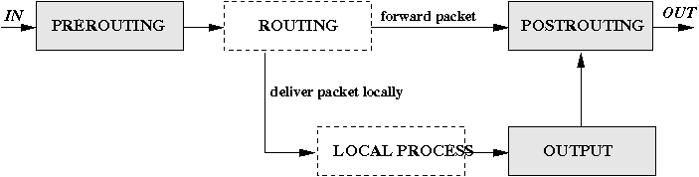
Programming NAT in Linux
The Linux kernel usually posesses a packet filter framework called netfilter
  It uses the iptables tool to write rules in the ‘nat’ table
  This table has three predefinded chains: PREROUTING, OUTPUT and POSTROUTING.
Notes:
The chains PREROUTING und POSTROUTING are the most important ones. As the name implies, the PREROUTING chain is responsible for packets that just arrived at the network interface. So far no routing decision has taken place, therefore it is not yet known whether the packet would be interpreted locally or whether it would be forwarded to another machine located at another network interface. After the packet has passed the PREROUTING chain the routing decision is made. In case that the local machine is the recipient, the packet will be directed to the corresponding process and we do not have to worry about NAT anymore. In case that the recipient is located in a (sub-)net located at a different network interface, the packet will be forwarded to that interface, provided that the machine is configured to do so. Just before our forwarded packet leaves the machine it passes the POSTROUTING chain and then leaves through the network interface. For locally generated packets there is a small difference: Instead of passing through the PREROUTING chain it passes the OUTPUT chain and then moves on to the POSTROUTING chain.

Slide 7
Programming NAT in Linux
The chains PREROUTING and POSTROUTING are the most important ones.
PREROUTING chain is responsible for packets that just arrived at the network interface.
  After the packet has passed the PREROUTING chain the routing decision is made.
In case that the local machine is the recipient, the packet will be directed to the corresponding process and we do not have to worry about NAT anymore.
Just before a forwarded packet leaves the machine it passes the POSTROUTING chain and then leaves through the network interface.
For locally generated packets they pass through the OUTPUT chain and then moves on to the POSTROUTING chain.

Slide 8
NAT in Linux - SNAT
The source IP for outgoing packets can be change using the following command
iptables -t nat -A POSTROUTING -s original_source_ip -d target_destination_server_ip -j SNAT --to-source new_source_ip
The –s and –d flags can be omitted if source IP address for all departing packets is to be re-written
Example:
iptables -t nat -A POSTROUTING -s 192.168.2.5 -j SNAT --to-source 10.4.181.100
Notes:
https://serverfault.com/questions/211974/how-do-i-do-ip-address-translation-with-iptables
https://unix.stackexchange.com/questions/243451/iptables-change-local-source-address-if-destination-address-matches

Slide 9
NAT in Linux - DNAT
The destination IP for incoming packets can be change using the following command
iptables -t nat -A PREROUTING -d original_destination_ip -s affected_source_server_ip -j DNAT --to-destination new_destination_ip
The –s and –d flags can be omitted if destination IP address for all incoming packets is to be re-written
Example:
iptables -t nat -A PREROUTING -d 10.4.181.100 -j SNAT --to-source 192.168.2.5

Slide 10
NAT in Linux - NAPT
NAPT can be enabled for this network using the following command on the router
iptables -t nat -A POSTROUTING -o eth1 -j MASQUERADE
Assumes eth1 is the network interface that faces the outside realm

Slide 11
Misuse of NAT
IP address spoofing to launch smurf attacks
IP address spoofing to launch MITM attacks
  This can be used to overcome IP address based access control e.g. IP restriction in HTTP (see apache example)
Notes:
https://www.karlrupp.net/en/computer/nat_tutorial

